Slide 1
Road Sign Manager
A cloud platform that converts and sends data to electronic road signs in New Haven

Slide 2
Partners
New Haven Transportation Department
Code4Good
Smarking
MakeHaven

Slide 3
Stack
Jade
Express
Node

Slide 4
Network Architecture
Binary String
Road Sign #1
Text
Road Sign Manager
Road Sign #2
Image
Road Sign #3
Parking API Data
Road Sign #4

Slide 5
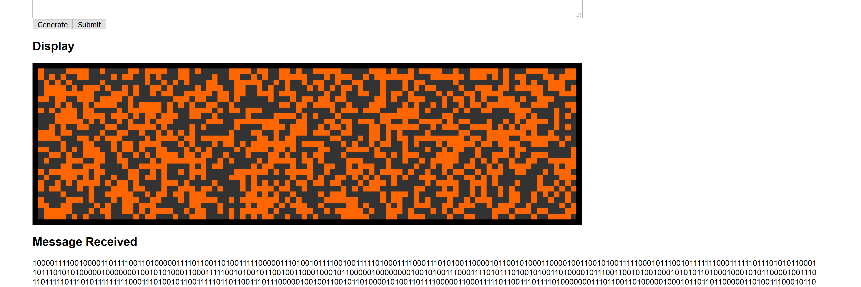
Testing
Road Sign Simulator

Slide 6
The Challenge
Converting various input types into a universal format: A binary string of length 2592 (i.e. regex /^[0-1]{2592}$/)

Slide 7
Demo
Hello World

